Slide 1
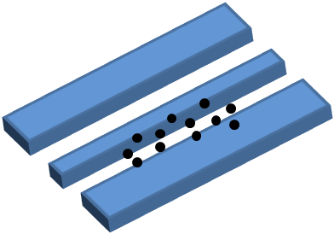
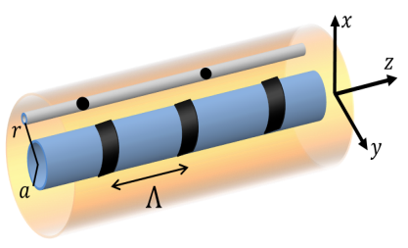

Long-range Interaction and Entanglement
Efi Shahmoon, Igor Mazets, Gershon Kurizki
Taipei L1
Notes:
TIME: 0:15
The topic of my talk: qubit coherent control or qubit manipulation using squeezed light

Slide 2

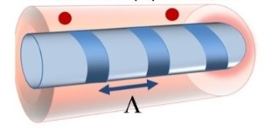

Outline
- “Transmitting” vacuum forces:
Giant vdW/Casimir via transmission lines
- Long-range dipolar interactions in fiber-grating
Deterministic excitation transfer (→ entanglement)
Laser-induced forces
→ Highly nonlocal NL optics: EIT + dipolar forces
Notes:
TIME: 0:15
The topic of my talk: qubit coherent control or qubit manipulation using squeezed light

Slide 3
Geometry dependence of vacuum forces
Point dipoles: vacuum fluctuations + scattering
- quasistatic (vdW)
- retarded (Casimir-Polder)
Dielectric/metallic mirrors:
Key point:
interaction via virtual-photons (from vacuum)
→ v. photons propagation & scattering → space dependence
object geometry
environment geometry
Our approach:
objects: dipoles (vdW),
environment: 1d space!
Giant vdW & Casimir in 1d
Notes:
TIME:1:00
I’d like to begin by introducing the problem that we address in our work which related to QC and QI.
As we all know the basic unit of a classic computer is the bit with two states, 0 or 1. A NOT gate would take 0 to 1 and vice versa
2. A quantum computer would be comprised of qubits which are quantum two level systems, say, a two level atom with the ground state and the excited state. Bare in mind that the qubit can be in every superposition of the two eigenstates unlike the classic bit. So a NOT gate would inverse the eigenstates in every such superposition.
3. realization of NOT gate: for a simplified atom qubit the NOT gate operation is achived by a light pulse that can inverse the atoms internal state. Such a light pulse is called a pi pulse.

Slide 4
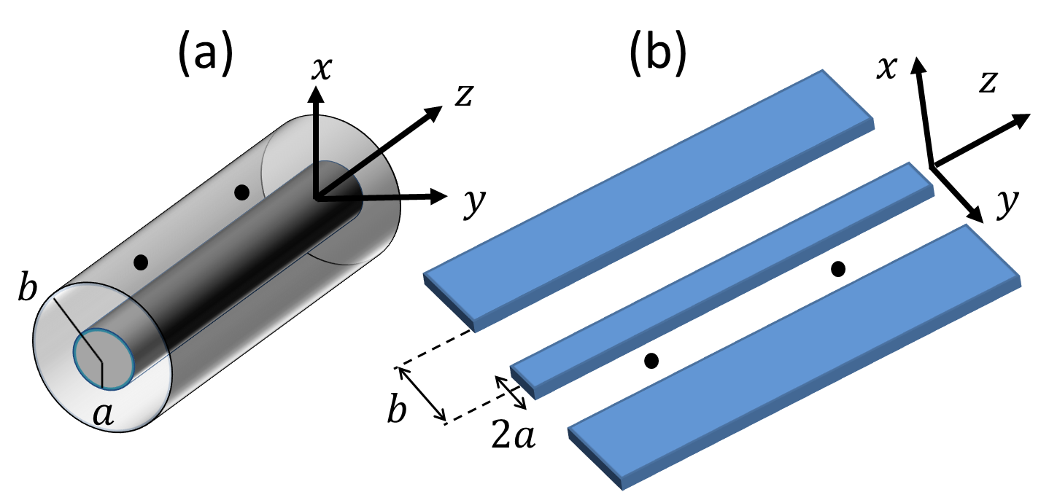
1. Giant vdW/Casimir
Transmission Lines
TL Geometries:
(a) Coaxial cable
(b) coplanar waveguide
microstrips, …
Transverse modes: TEM + other modes with cutoffs
(e.g.
for coax)
TEM mode → 1d photon vacuum modes!
Dispersion:
Mode function:
TEM mode → “free space” in 1d
Notes:
TIME:1:00
I’d like to begin by introducing the problem that we address in our work which related to QC and QI.
As we all know the basic unit of a classic computer is the bit with two states, 0 or 1. A NOT gate would take 0 to 1 and vice versa
2. A quantum computer would be comprised of qubits which are quantum two level systems, say, a two level atom with the ground state and the excited state. Bare in mind that the qubit can be in every superposition of the two eigenstates unlike the classic bit. So a NOT gate would inverse the eigenstates in every such superposition.
3. realization of NOT gate: for a simplified atom qubit the NOT gate operation is achived by a light pulse that can inverse the atoms internal state. Such a light pulse is called a pi pulse.

Slide 5
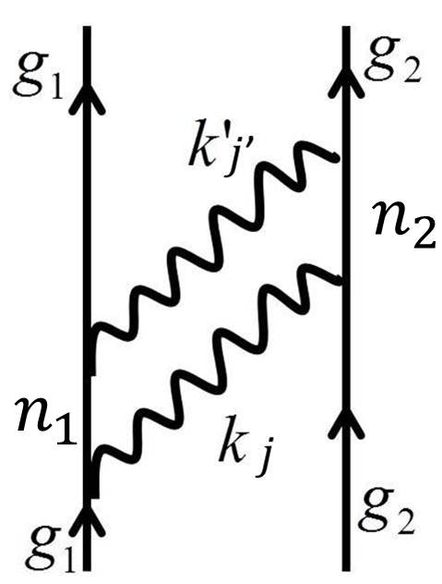
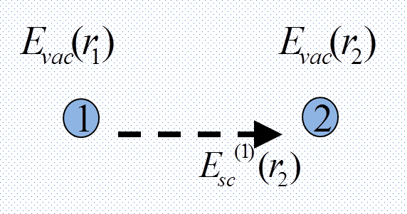
1. Giant vdW/Casimir
Analytical approaches
Shahmoon, Mazets & Kurizki, PNAS 111, 10485 (2014)
TEM-mediated vdW/Casimir
1. QED perturbation theory
2. Scattering of vac. fluctuations
P. Milonni, “The Quantum Vacuum” (1994)
D. Craig & T. Thirunamachandran, “Molecular QED” (1984)
Spruch & Kelsey, PRA (1978)
Notes:
TIME:1:00
I’d like to begin by introducing the problem that we address in our work which related to QC and QI.
As we all know the basic unit of a classic computer is the bit with two states, 0 or 1. A NOT gate would take 0 to 1 and vice versa
2. A quantum computer would be comprised of qubits which are quantum two level systems, say, a two level atom with the ground state and the excited state. Bare in mind that the qubit can be in every superposition of the two eigenstates unlike the classic bit. So a NOT gate would inverse the eigenstates in every such superposition.
3. realization of NOT gate: for a simplified atom qubit the NOT gate operation is achived by a light pulse that can inverse the atoms internal state. Such a light pulse is called a pi pulse.

Slide 6
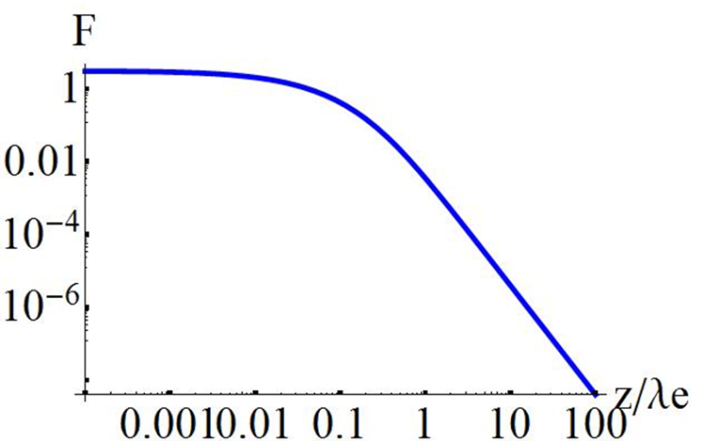
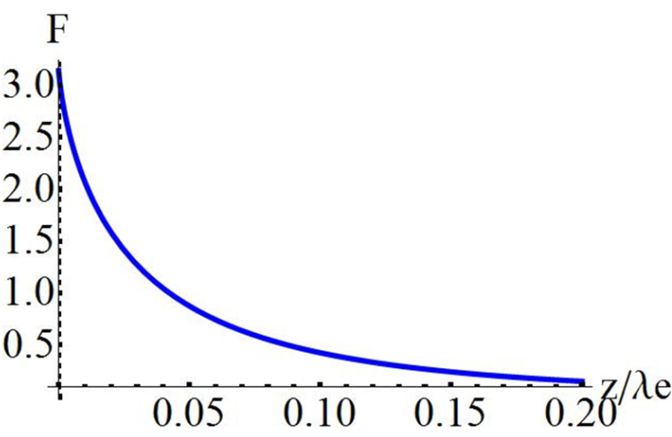
1. Giant vdW/Casimir
Interaction energy mediated by TEM mode
Both analytical approaches yield identical results
dipole:
obtain:
vdW regime:
Casimir-Polder (retarded) regime:
Shahmoon, Mazets & Kurizki, PNAS 111, 10485 (2014)
Notes:
TIME:1:00
I’d like to begin by introducing the problem that we address in our work which related to QC and QI.
As we all know the basic unit of a classic computer is the bit with two states, 0 or 1. A NOT gate would take 0 to 1 and vice versa
2. A quantum computer would be comprised of qubits which are quantum two level systems, say, a two level atom with the ground state and the excited state. Bare in mind that the qubit can be in every superposition of the two eigenstates unlike the classic bit. So a NOT gate would inverse the eigenstates in every such superposition.
3. realization of NOT gate: for a simplified atom qubit the NOT gate operation is achived by a light pulse that can inverse the atoms internal state. Such a light pulse is called a pi pulse.

Slide 7

1. Giant vdW/Casimir
Comparison with free-space result
- TEM-mediated energy:
vdW regime
- free-space counterpart:
- For
(e.g. circuit QED)
from
Giant enhancement
w.r.t free-space
Casimir-Polder regime
Free-space regime:
- include transverse mode other then TEM
(e.g.
- Free-space result is restored
(numerically verified for coax & metal waveguide)
E. Shahmoon, & G. Kurizki, PRA 87, 062105 (2013)
Shahmoon, Mazets & Kurizki, PNAS 111, 10485 (2014)
Notes:
TIME:1:00
I’d like to begin by introducing the problem that we address in our work which related to QC and QI.
As we all know the basic unit of a classic computer is the bit with two states, 0 or 1. A NOT gate would take 0 to 1 and vice versa
2. A quantum computer would be comprised of qubits which are quantum two level systems, say, a two level atom with the ground state and the excited state. Bare in mind that the qubit can be in every superposition of the two eigenstates unlike the classic bit. So a NOT gate would inverse the eigenstates in every such superposition.
3. realization of NOT gate: for a simplified atom qubit the NOT gate operation is achived by a light pulse that can inverse the atoms internal state. Such a light pulse is called a pi pulse.

Slide 8
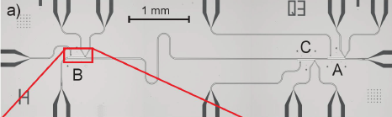
1. Giant vdW/Casimir
Possible realization: Circuit QED
TL: superconducting coplanar waveguide
Dipole: superconducting qubit/“transmon”
Measurement of interaction energy for a single pair of dipoles!
Observable: energy shift of dipole level
Wallraff (ETH)
Typical parameters [1-3]:
vdW limit
Casimir-Polder regime
(level width)
detectable!
very challenging
[1] Shahmoon, Mazets & Kurizki, PNAS (2014)
(with present tech.)
[2] Baur et al. Phys. Rev. Lett. 108, 040502 (2012)
[3] Stojanovi’c et al. Phys. Rev. B 85, 05404 (2012)
Notes:
TIME:1:00
I’d like to begin by introducing the problem that we address in our work which related to QC and QI.
As we all know the basic unit of a classic computer is the bit with two states, 0 or 1. A NOT gate would take 0 to 1 and vice versa
2. A quantum computer would be comprised of qubits which are quantum two level systems, say, a two level atom with the ground state and the excited state. Bare in mind that the qubit can be in every superposition of the two eigenstates unlike the classic bit. So a NOT gate would inverse the eigenstates in every such superposition.
3. realization of NOT gate: for a simplified atom qubit the NOT gate operation is achived by a light pulse that can inverse the atoms internal state. Such a light pulse is called a pi pulse.

Slide 9
2. Long-range DDI
Coherent dipole-dipole interaction (DDI)
“incoherent” interaction
atom 1 spontaneously emits photon to atom 2
- dissipative
- probabilistic excitation exchange
- non-conservative forces (via scattering)→ diffusion
- scaling: 3d: 1d:
“coherent” interaction
via evanescent/“near” fields, virtual photons
- dispersive
- deterministic (Hamiltonian) excitation exchange
- conservative forces (potentials)
- scaling: 3d:
0’ Dell, Giovanazzi, GK, PRL (00’, 02’)
1d:
Goal: coherent & long-range interaction
Notes:
TIME:1:00
I’d like to begin by introducing the problem that we address in our work which related to QC and QI.
As we all know the basic unit of a classic computer is the bit with two states, 0 or 1. A NOT gate would take 0 to 1 and vice versa
2. A quantum computer would be comprised of qubits which are quantum two level systems, say, a two level atom with the ground state and the excited state. Bare in mind that the qubit can be in every superposition of the two eigenstates unlike the classic bit. So a NOT gate would inverse the eigenstates in every such superposition.
3. realization of NOT gate: for a simplified atom qubit the NOT gate operation is achived by a light pulse that can inverse the atoms internal state. Such a light pulse is called a pi pulse.

Slide 10
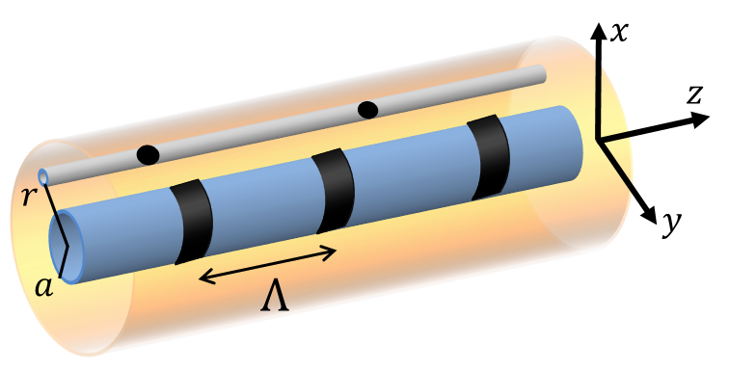
2. Long-range DDI
Long-range coherent interactions via fiber-grating
Fiber-grating (FG) = 1d photonic crystal
bandgap
density
of states
(=DOS)
bandgap
DDI & scat. for inside gap:
(due to DOS)
Close to bandgap edge:
1. strong:
2. long-range:
Applications:
Shahmoon & Kurizki, PRA 87, 033831 (2013)
1. Excitation exchange → long-range deterministic entanglement
Shahmoon & Kurizki, PRA 89, 043419 (2014)
Douglas et al. Nature Photon. (2015)
2. Laser-induced inter-atomic force → non-extensive thermodyn.
Shahmoon, Mazets & Kurizki, Opt. Lett. (2014)

Slide 11
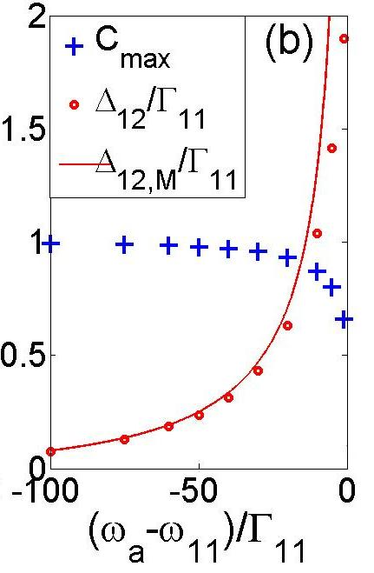
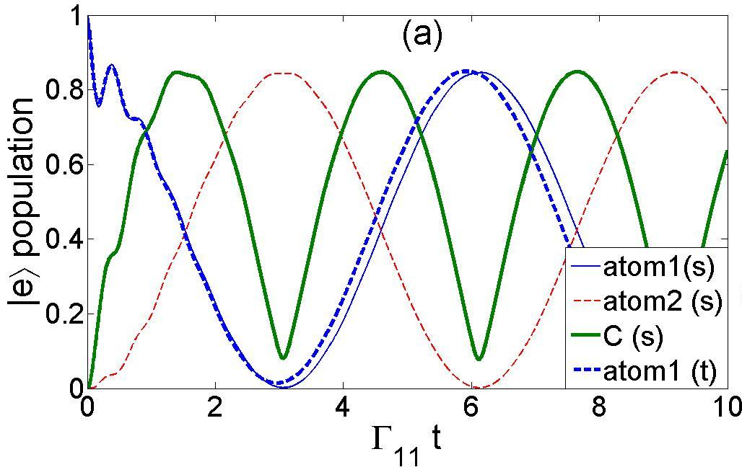
2. Long-range DDI
DD interaction: non-Markovian theory
The theory: *Schrodinger Eq. for 2 atoms+waveguide vacuum
*Solved using Laplace transform
excited-level lifetime
in free-space
Fixed distance z, ωa near cutoff:
- interaction strength gets larger (divergence)
- population loss (incomplete decay) → less entanglement
Notes:
TIME:1:00
I’d like to begin by introducing the problem that we address in our work which related to QC and QI.
As we all know the basic unit of a classic computer is the bit with two states, 0 or 1. A NOT gate would take 0 to 1 and vice versa
2. A quantum computer would be comprised of qubits which are quantum two level systems, say, a two level atom with the ground state and the excited state. Bare in mind that the qubit can be in every superposition of the two eigenstates unlike the classic bit. So a NOT gate would inverse the eigenstates in every such superposition.
3. realization of NOT gate: for a simplified atom qubit the NOT gate operation is achived by a light pulse that can inverse the atoms internal state. Such a light pulse is called a pi pulse.

Slide 12
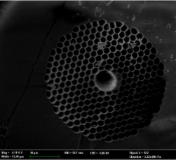

2. Long-range DDI
Inter-atomic forces: laser-induced DDI (LI-DDI)
LIDDI [1]:
Examples:
Free-space [2]
photon Green’s function
Fiber-mediated [3]
→ long-range interaction!
tapered-fiber
(Rauschenbeutel, Kimble)
hollow-fiber
(Lukin, Gaeta)
Problem: spontaneous emission/scattering (e.g. Rayleigh) → diffusion
can have
[2] O’Dell, Giovanazzi, Kurizki & Akulin, PRL (2000)
[1] ES & Kurizki, PRA 89, 043419 (2014)
[3] Chang, Cirac & Kimble, PRL 110, 113606 (2013)

Slide 13
3. Highly nonlocal NLO
EIT + DDI (dipolar int.) = nonlocal NLO
Fleischhauer & Lukin (2002)
NLO=nonlinear optics
photon
Atom excitation
E-field
g-d spin wave
dipolar interaction of atoms
(for atoms in state d)
interaction of photons
(I=intensity)
Friedler, Petrosyan,
Kurizki & Fleischhauer
(PRA 2005)
→ NL optics with EIT: nonlocal Kerr effect
implications:
Rydberg
→ Extremely Strong NLO
Lukin (Harvard), Firstenberg (WIS)
Adams, Hofferberth, Rempe,…
In fibers: et al. (PRA 83, 2011)
modified long-range DDI interactions?
→ Extremely nonlocal NLO
Shahmoon, Grisins, Stimming, Mazets & Kurizki, arXiv:1412.8331;
Optica 3, 725 (2016)
Notes:
13

Slide 14
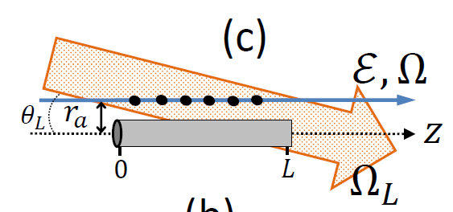
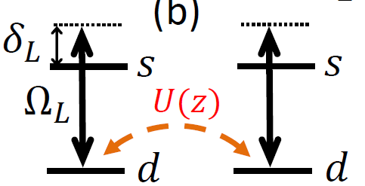
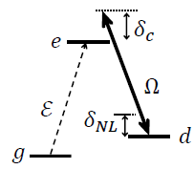
3. Highly nonlocal NLO
Proposed scheme
1. Laser-induced DDI potential between atoms in
2. Use level in an EIT scheme
→ Nonlinear level shift and detuning:
atom density
occupation of level d for atom at z
Notes:
14

Slide 15





3. Highly nonlocal NLO
Resulting nonlocal nonlinear propagation
What propagates in the EIT medium?
EIT polariton = superposition of light and spin waves
Resulting propagation:
wave
frequency shift
dispersion (“mass”)
- linear shift
resulting from freq. shift
- nonlinear shift (SPM)
Nonlocal nonlinear shift:
Nonlocal + nonlinear dispersion
→ New regime of nonlinear optics!
Optica 3, 725 (2016)
Notes:
15

Slide 16
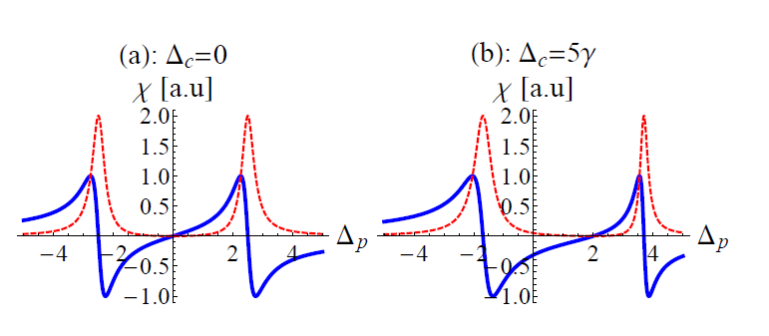
3. Highly nonlocal NLO
Origin of nonlinear dispersion
frequency shift
→ resulting from freq. shift
Quadratic dispersion of probe appears for
Notes:
TIME: 0:15
The topic of my talk: qubit coherent control or qubit manipulation using squeezed light

Slide 17



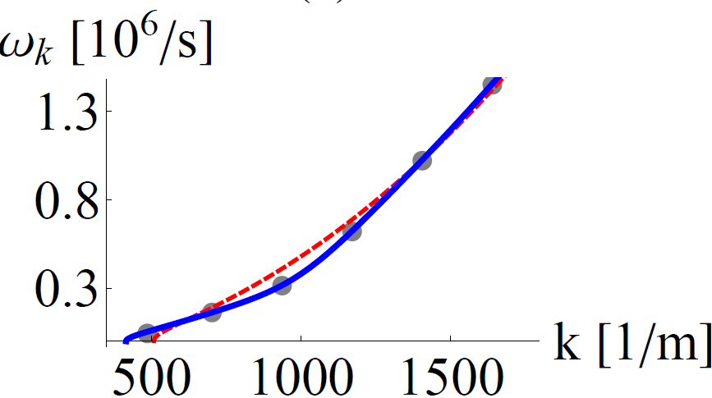
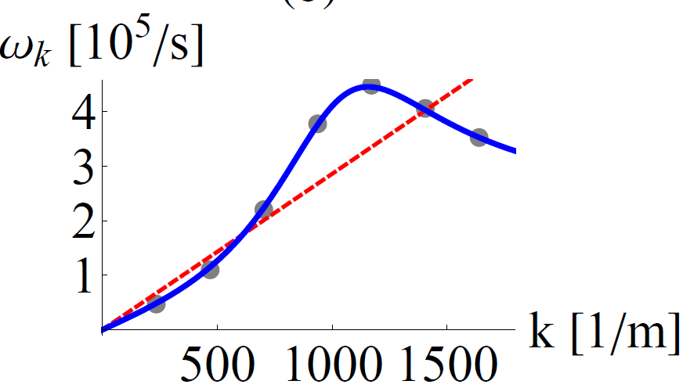
3. Highly nonlocal NLO
Predictions (1): optical roton
Long-range interaction via nano-waveguide + grating:
Dispersion relation of wave excitations about a CW (Bogoliubov):
Photon density of CW
quadratic dispersion:
optical roton
optical “anti-roton”
blue: long-range int.
red: local int.
roton extrema at
→ spatial ordering at
Notes:
17

Slide 18
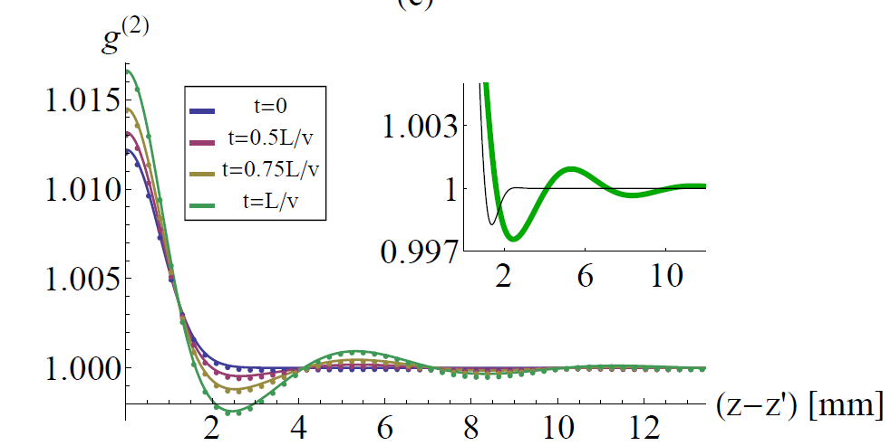
3. Highly nonlocal NLO
Predictions (2): emergence of spatial self-order
Instability: imaginary dispersion peaked at
→ pair generation: peaked around
→ emergence of order in field intensity with period ~
delta-corr. field
local vs. nonlocal
photon detector
Green: intensity corr. at waveguide output
Other colors: intensity corr. at different stages t during propagation in waveguide
Notes:
18

Slide 19
3. Highly nonlocal NLO
Instability: spectrum
ES, Grisins, Stimming, Mazets & Kurizki (in preparation)
Im. part of Bogoliubov spectrum
Squeezing spectrum
Mode occupation
Notes:
19

Slide 20

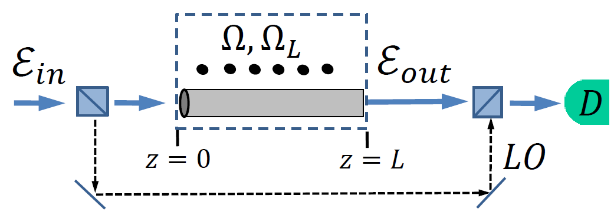
3. Highly nonlocal NLO
Measuring the optical roton spectra
ES, Grisins, Stimming, Mazets & Kurizki (in preparation)
Photon density of CW
optical “anti-roton”
homodyne detection
Notes:
20

Slide 21
2. Long-range DDI
Many-body physics with long-range interactions
1
2
interaction/”surface” energy
total energy
short-range int.
long-range int.
non-additive!
Long-range interactions:
Stat. physics + long range int. (=Non-additive sys.)
→ New concepts & predictions: - inequivalence of stat. ensembles
- Negative specific heat
No (controlled) experiments!
- Breaking of ergodicity
Mukamel, arXiv: 0905.1457
Campa, Dauxois & Ruffo, Phys. Rep. (2009)
Mukamel, arXiv: 0905.1457
Campa, Dauxois & Ruffo, Phys. Rep. (2009)
Notes:
TIME:1:00
I’d like to begin by introducing the problem that we address in our work which related to QC and QI.
As we all know the basic unit of a classic computer is the bit with two states, 0 or 1. A NOT gate would take 0 to 1 and vice versa
2. A quantum computer would be comprised of qubits which are quantum two level systems, say, a two level atom with the ground state and the excited state. Bare in mind that the qubit can be in every superposition of the two eigenstates unlike the classic bit. So a NOT gate would inverse the eigenstates in every such superposition.
3. realization of NOT gate: for a simplified atom qubit the NOT gate operation is achived by a light pulse that can inverse the atoms internal state. Such a light pulse is called a pi pulse.

Slide 22

Summary
- Dipolar interactions in confined geometries
Confined geometries → modify modes → enhance dipolar int.
mode
function
simple idea, drastic consequences!
1. Transmission lines: → TEM “1d”-mode
→ Giant Casimir effects in 1d → realization: circuit QED
2. Cutoffs & gaps in photon DOS
Z=inter-dipolar distance
→ enhanced dispersive int. ; inhibited dissipative effects
- Long-range deterministic entanglement generation
- Long-range laser-induced forces: nonlocal NL optics, non-extensive thermo.
Notes:
TIME:1:00
I’d like to begin by introducing the problem that we address in our work which related to QC and QI.
As we all know the basic unit of a classic computer is the bit with two states, 0 or 1. A NOT gate would take 0 to 1 and vice versa
2. A quantum computer would be comprised of qubits which are quantum two level systems, say, a two level atom with the ground state and the excited state. Bare in mind that the qubit can be in every superposition of the two eigenstates unlike the classic bit. So a NOT gate would inverse the eigenstates in every such superposition.
3. realization of NOT gate: for a simplified atom qubit the NOT gate operation is achived by a light pulse that can inverse the atoms internal state. Such a light pulse is called a pi pulse.

Slide 23
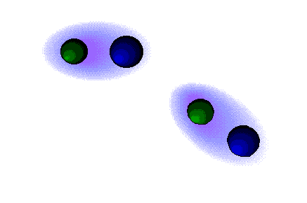
Appendix
Notes:
TIME: 0:15
The topic of my talk: qubit coherent control or qubit manipulation using squeezed light

Slide 24
3. Highly nonlocal NLO
Imperfections & scattering
1. Scattering due to laser-induced DDI
Bandgap: scat. only to non-guided → weak!
2. Scattering from defects in WG
Douglas et al. Nature Photon. (2015)
single-atom effect
but our observable is cooperative!
3. EIT absorption

Slide 25

1. Giant vdW/Casimir
Analytical approaches
ES, I. Mazets & G. Kurizki, arXiv: 1304:2028 (2013)
1. QED perturbation theory
2. Scattering of vac. fluctuations
4th order energy correction for
Find scattered field in 1d (TEM):
Dipole model:
Averaging over vacuum:
Vacuum modes: TEM
D. Craig & T. Thirunamachandran, “Molecular QED” (1984)
P. Milonni, “The Quantum Vacuum” (1994)
Notes:
TIME:1:00
I’d like to begin by introducing the problem that we address in our work which related to QC and QI.
As we all know the basic unit of a classic computer is the bit with two states, 0 or 1. A NOT gate would take 0 to 1 and vice versa
2. A quantum computer would be comprised of qubits which are quantum two level systems, say, a two level atom with the ground state and the excited state. Bare in mind that the qubit can be in every superposition of the two eigenstates unlike the classic bit. So a NOT gate would inverse the eigenstates in every such superposition.
3. realization of NOT gate: for a simplified atom qubit the NOT gate operation is achived by a light pulse that can inverse the atoms internal state. Such a light pulse is called a pi pulse.

Slide 26

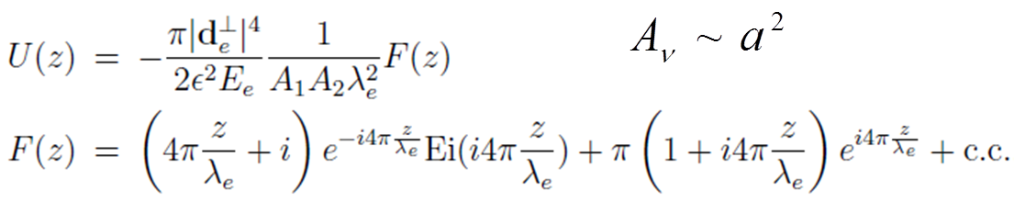
1. Giant vdW/Casimir
Theory
QED Hamiltonian
TEM-mediated interaction energy
dipole matrix element
Notes:
TIME:1:00
I’d like to begin by introducing the problem that we address in our work which related to QC and QI.
As we all know the basic unit of a classic computer is the bit with two states, 0 or 1. A NOT gate would take 0 to 1 and vice versa
2. A quantum computer would be comprised of qubits which are quantum two level systems, say, a two level atom with the ground state and the excited state. Bare in mind that the qubit can be in every superposition of the two eigenstates unlike the classic bit. So a NOT gate would inverse the eigenstates in every such superposition.
3. realization of NOT gate: for a simplified atom qubit the NOT gate operation is achived by a light pulse that can inverse the atoms internal state. Such a light pulse is called a pi pulse.

Slide 27
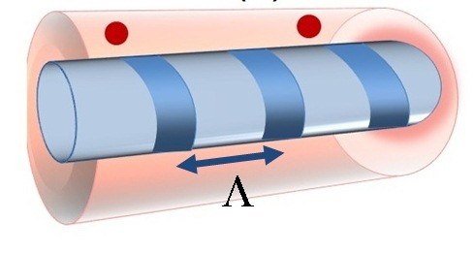


2. Long-range DDI
Energy transfer: deterministic entanglement
Realization: nano-waveguide + Bragg grating
1. In bandgap:
incoherent radiation to non-guided modes
2. @ bandgap edge:
bandgap
strong
bandgap
long-distance
atoms:
MHz
Rauschenbeutel, Kimble
ES & Kurizki, PRA 87, 033831 (2013)
See also works by Darrick Chang
Notes:
TIME:1:00
I’d like to begin by introducing the problem that we address in our work which related to QC and QI.
As we all know the basic unit of a classic computer is the bit with two states, 0 or 1. A NOT gate would take 0 to 1 and vice versa
2. A quantum computer would be comprised of qubits which are quantum two level systems, say, a two level atom with the ground state and the excited state. Bare in mind that the qubit can be in every superposition of the two eigenstates unlike the classic bit. So a NOT gate would inverse the eigenstates in every such superposition.
3. realization of NOT gate: for a simplified atom qubit the NOT gate operation is achived by a light pulse that can inverse the atoms internal state. Such a light pulse is called a pi pulse.

Slide 28
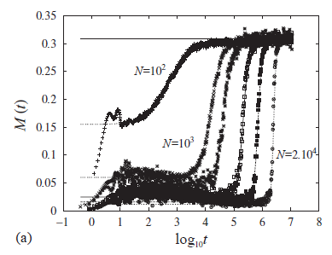
2. Long-range DDI
Mapping to 2d spin (XY) model
LI-DDI for may-atoms
atom position 2d spin orientation
ordered state
→ known spin (XY) model!
→ slow relaxation in μ-canonical [*]
~ system size!
never observed!
ES, Mazets & Kurizki, Opt. Lett. 39, 3674 (2014)
[*] Yamaguchi et al., Physica A 337, 36 (2004)

Slide 29
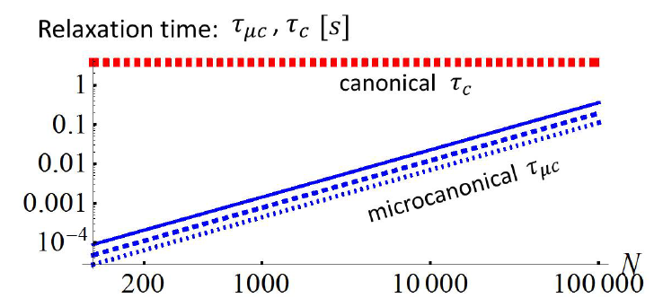
2. Long-range DDI
Battle of relaxations
.
.
.
Dynamics:
μ-canonical (slow) relaxation
canonical relaxation
via: atomic “collisions” (LI-DDI)
vs.
via: photon scattering
to: equilibrium determined by sys. initial state
to: equilibrium determined by effective T
time:
~ system size!
time:
For Cs atoms:
→ Can experimentally probe slow relaxation!
→ Probe this ensemb. inequivalence
Probe many-body effect
of long-range int.!
ES, Mazets & Kurizki, Opt. Lett. 39, 3674 (2014)

Slide 30



2. Long-range DDI
Mapping to spin model
ES, Mazets & Kurizki, arXiv:1309.0555 (2013)
- LIDDI + kinetic energy lead to
position, momentum & mass of atom i
laser wavelength
→ known XY model! → slow relaxation in μ-canonical [1]
BUT:
in our case:
- Scattering → friction + diffusion = effective bath → canonical ensemble…
→ Dynamics= XY model + friction + diffusion (Langevin):
see Cohen-Tannoudji
[1] Yamaguchi et al., Physica A 337, 36 (2004)

